Slide 1

IGARSS
7-12 July 2024
Machine learning models for EOS SAT-1 satellite image enhancing
First author: Viacheslav Popika Paper ID: 4347

Slide 2

Outline
EOS SAT-1
Images from EOS SAT-1
Standard SR pipeline
Why it can not work
Why standard pipeline doesn't work
Our super-resolution pipeline (Distortion network)
Interim result
The difference
Distorsions by the neural network
Solving the problem
After processing
Results
Summary
Metrics
Questions

Slide 3
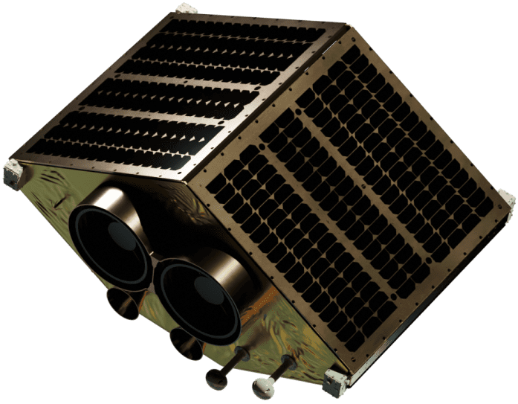
EOS SAT-1
GSD (ground sample distance), resolution:
panchromatic 1.4 m
multispectral 2.8 m
Swath width: double optical payload with a 44 km swath
width for an altitude of 500 km.
Spectral bands — 11 agri-related bands:
RGB
2 NIR bands
3 RedEdge bands
Water Vapor
Aerosol
Pan.

Slide 4
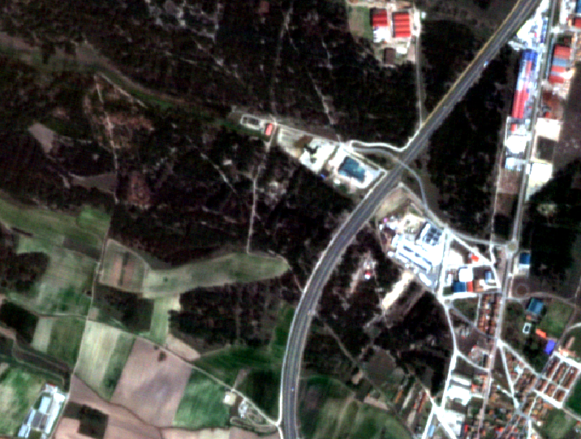
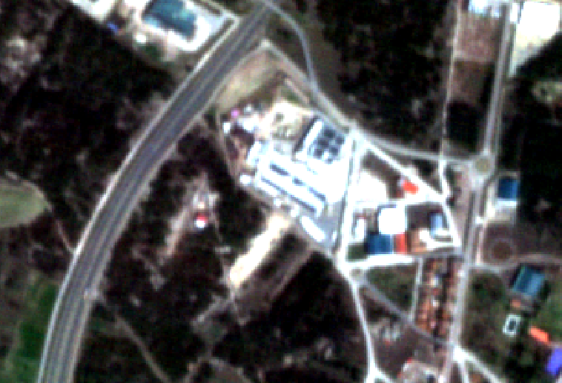
Beautiful image from EOS SAT-1
But can we make it better?

Slide 5
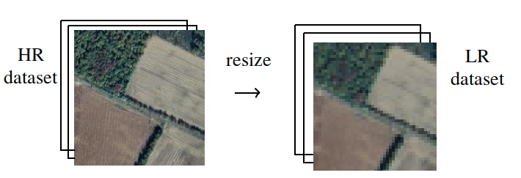
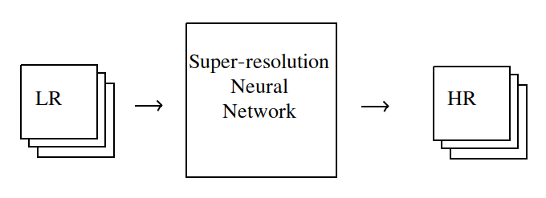
A standard super-resolution pipeline
We take a dataset of high-resolution images and their corresponding low-resolution images.
We train a neural network to convert low-resolution images into high-resolution images.
Then, we take images from our satellite and input them into the trained neural network for upscaling.

Slide 6
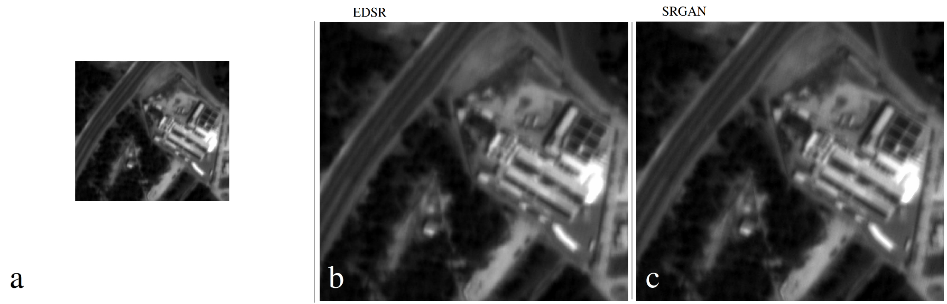
A standard super-resolution pipeline
is it work for us?
Visual comparisons of popular SR methods on a panchromatic image:
a) original low resolution image
b) EDSR
c) SRGAN

Slide 7
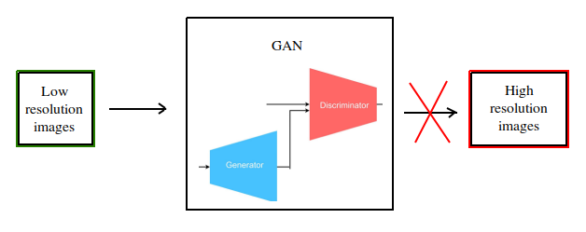
Why standard pipeline doesn't work
Because we do not actually have high-resolution images corresponding to each image from our satellite.
The images we take from other satellites will have different parameters, different point spread functions, and therefore the model trained on these images cannot work on our specific satellite. However, it can work on images with similar parameters.

Slide 8
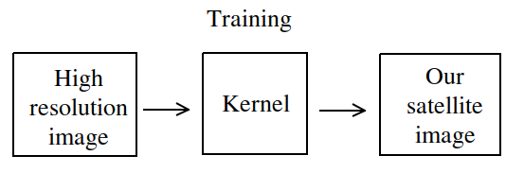
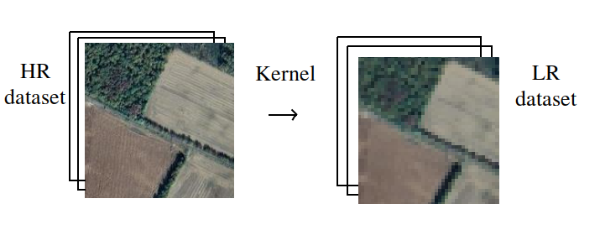
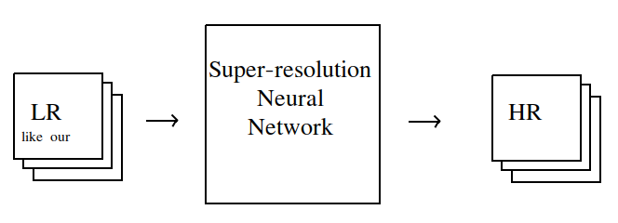
Our super-resolution pipeline
We prepare high-resolution and low-resolution data in such a way that they look exactly like they would if they were from our satellite.
To achieve this, we replicate the differences between our satellite and our training data using a small neural network.
Using this small neural network, we create synthetic data similar to the EOS satellite data for training.

Slide 9
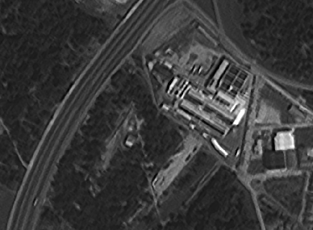
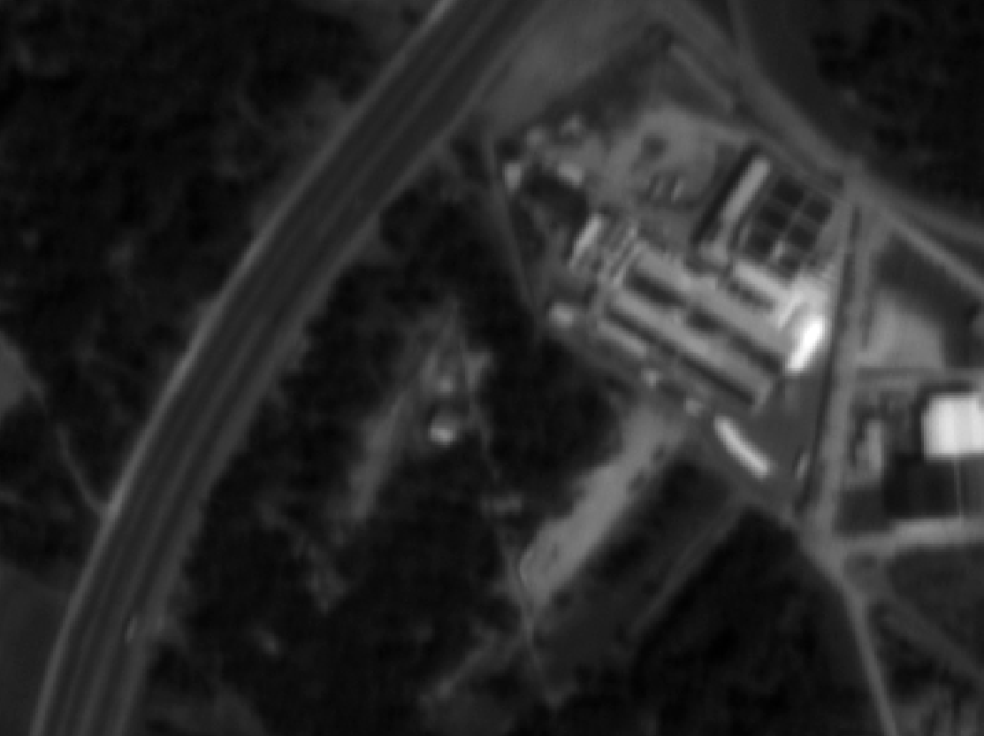
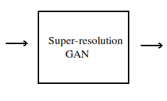
The Interim result

Slide 10
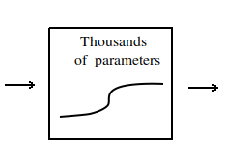
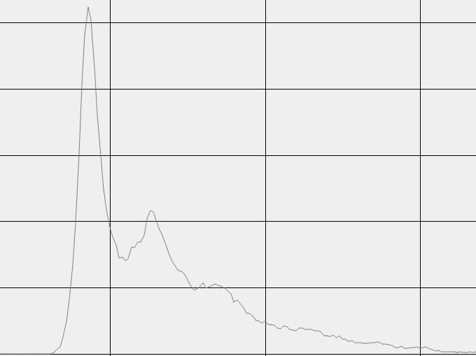
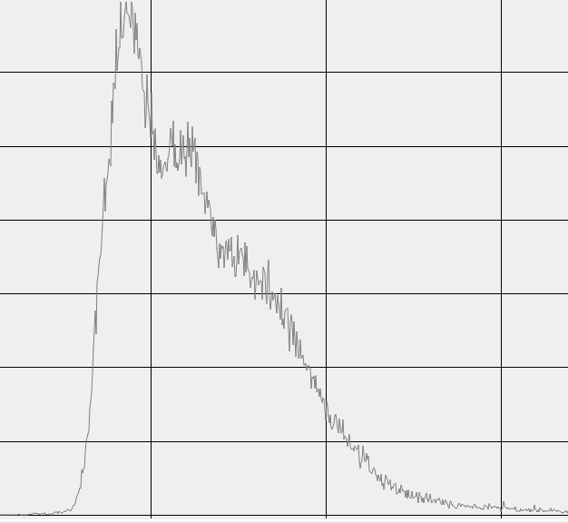
The difference

Slide 11
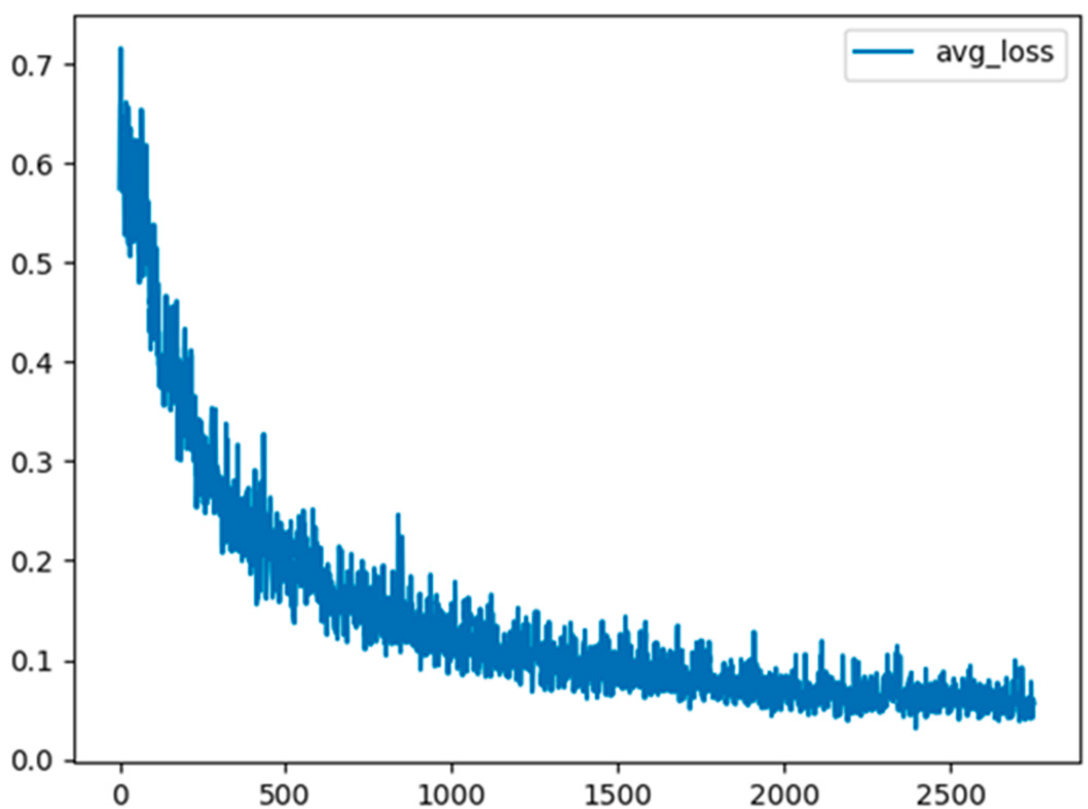
Part 2 - distortions by the neural network
If you choose a good architecture for super-resolution, have a large dataset, and train for a long time, you will achieve a very small error value, which is very good.
If you have a small dataset or do not train a large network long enough, you will have a high error value.
However, the loss function value will never be zero.

Slide 12
Solving the problem
We can train better neural networks, train them for longer periods, and use larger datasets but it can be endless game.
However, we can also find an alternative approach.
For example, if the average value has increased or decreased, we can simply calculate the average value of the new image and multiply it by a coefficient so that our new image has the same average as the original. But this has a drawback - it does not affect the local difference.

Slide 13
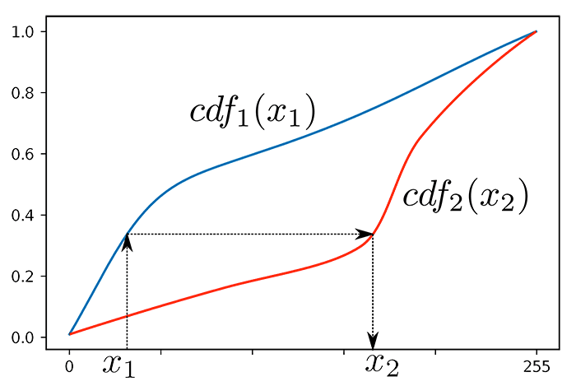
Solving the problem
We can also apply the histogram matching algorithm.
However, although it makes the histograms identical and the images visually similar, pixel-wise metrics such as SSIM will show a significant difference between the images before and after.

Slide 14
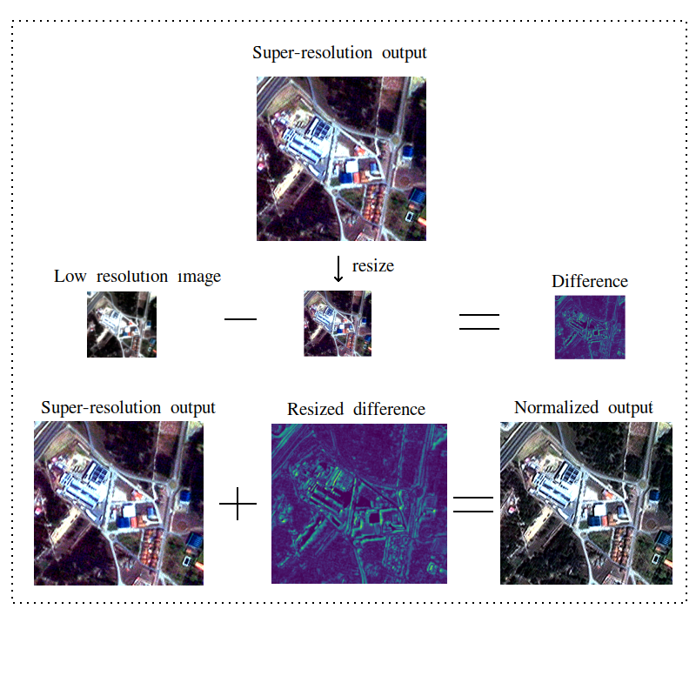
After processing

Slide 15
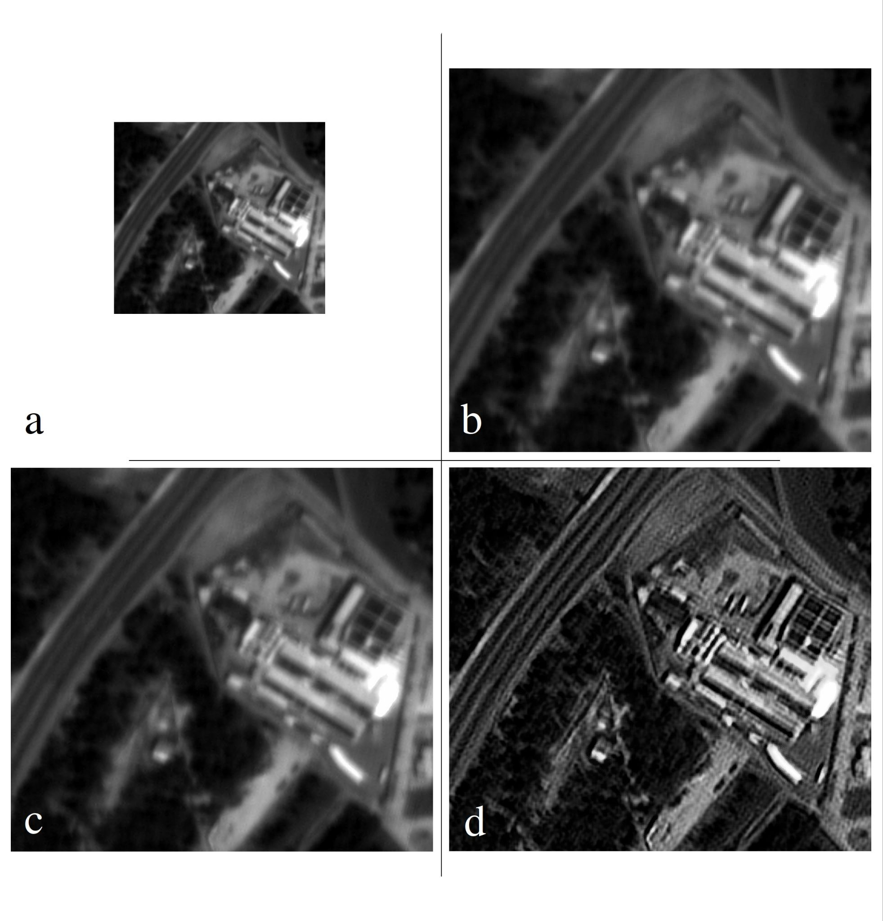
Results
Visual comparisons of the proposed method with other SR methods on a panchromatic image:
a) original low resolution image
b) EDSR[7]
c) SRGAN[1] (standard)
d) our

Slide 16
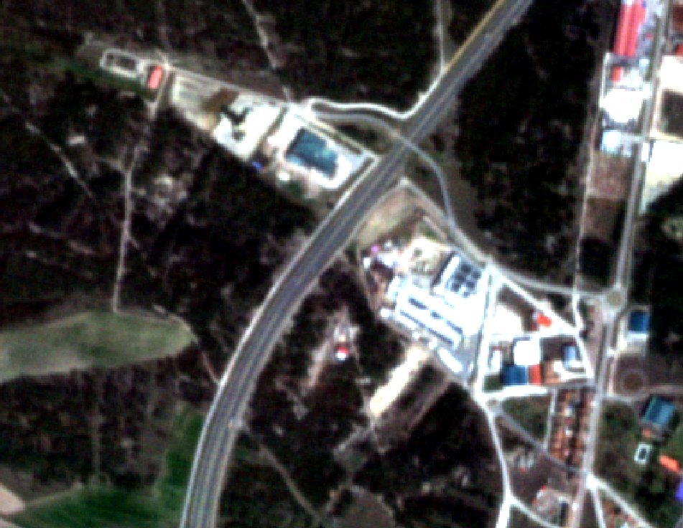
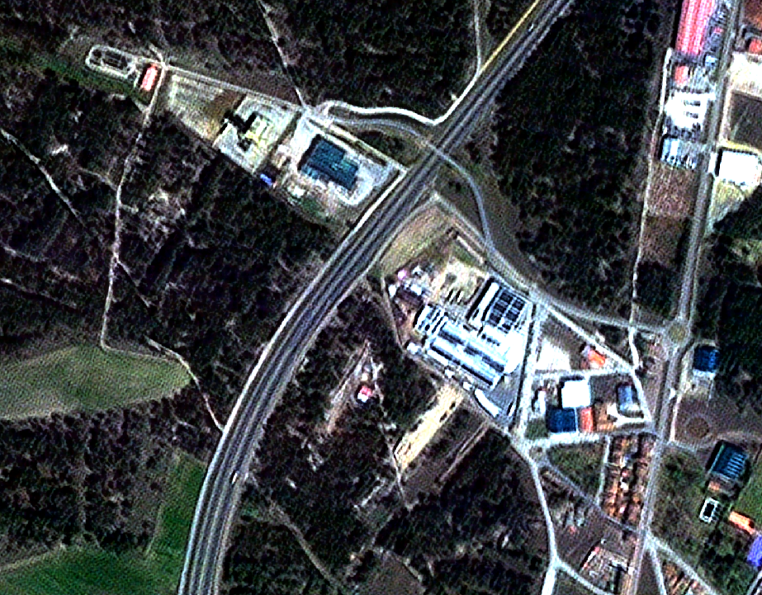
Results
Before After

Slide 17
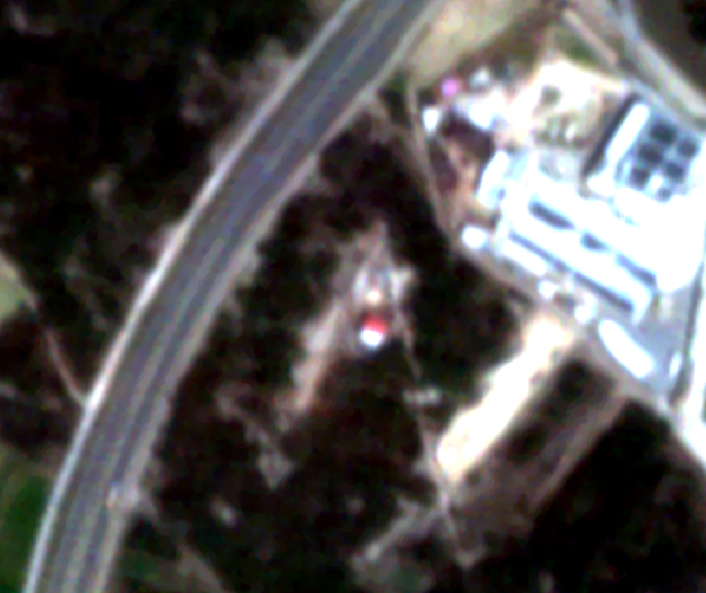
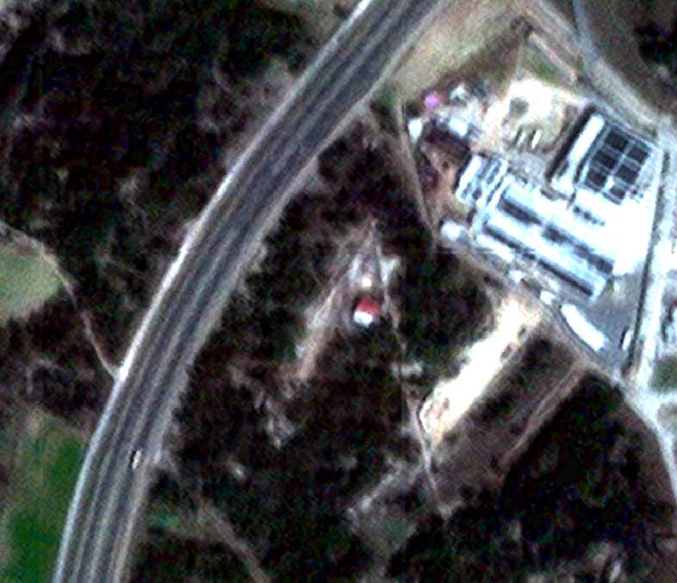
Results
Before After

Slide 18
In summary, our approach includes four stages.
Stage 1: We train a distortion network, referred to as the "Distortion Network". The network is trained to approximate the high-resolution and quality features of the template onto our lower quality satellite image.
Stage 2: In the next, we utilize the Distortion Network to generate training data by inputting a high-quality image dataset. The network then produces a diverse set of data with distortions analogous to those introduced by our distortion function.
Stage 3: In the third phase, we leverage both high-quality and low-quality datasets obtained through the Distortion Network. These datasets serve as inputs for training the Super-Resolution Generative Adversarial Network
Stage 4: The final stage focuses on post-processing the output image, addressing potential nonlinear changes introduced by the neural network.

Slide 19
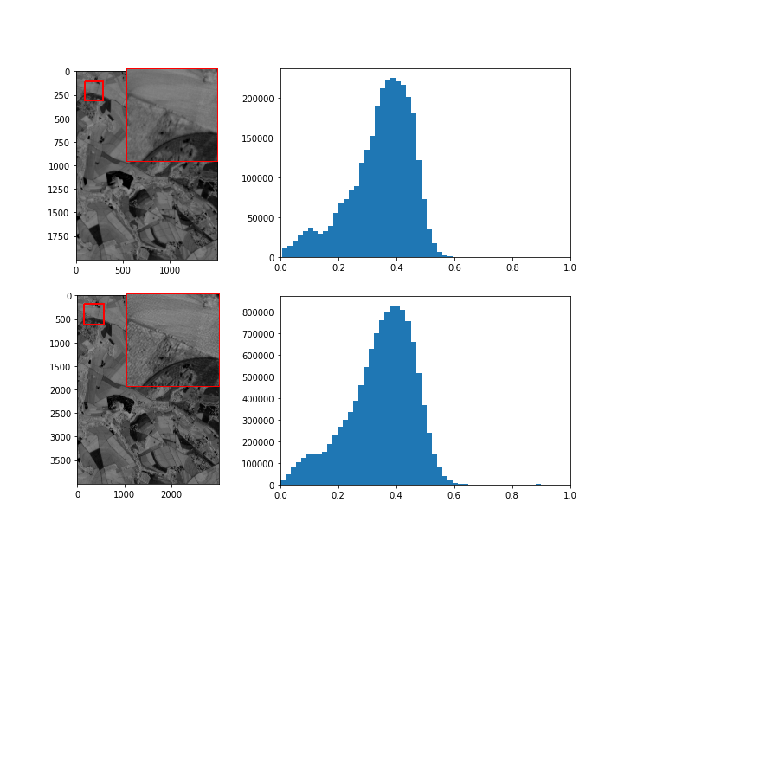
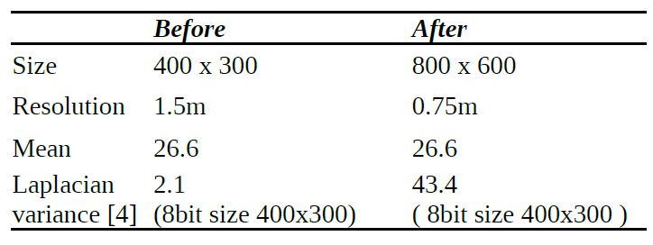
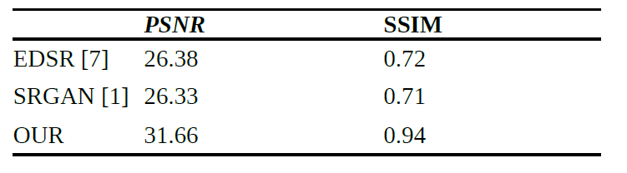
Metrics

Slide 20
Questions?
Viacheslav Popika
popikeyshen@gmail.com

